Slide 1
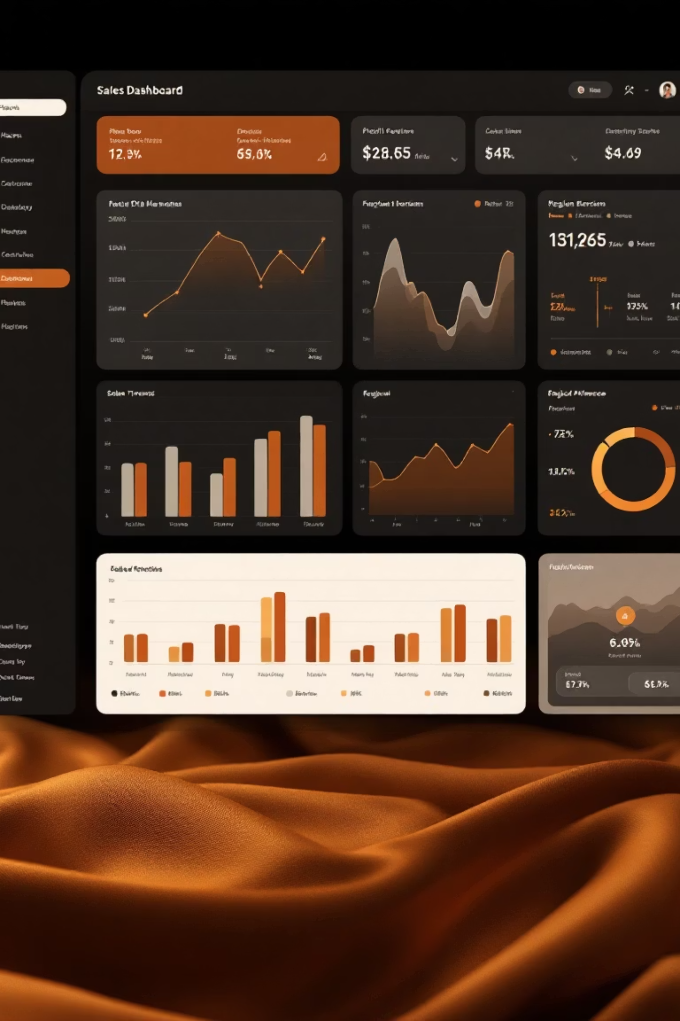
SuperStore Sales Dashboard – Task 3
Data Analyst Internship
Savaram Sai Sathya Dheeraj | August 2025

Slide 2

Project Objective
Create a comprehensive, interactive dashboard that visualizes key sales metrics and profit trends from the SuperStore dataset.
Project Specifications
Tool: Power BI
Enable stakeholders to make quick, data-driven business decisions through intuitive filtering and dynamic visualizations.
Dataset: Super Store_Sales.csv
Timeframe: 2 weeks

Slide 3
Dataset Overview
Data Structure
Time Range
Data Quality
The SuperStore dataset contains 9,994 records with 21 columns including sales transactions, customer details, product information, and geographical data.
Four years of sales data (2014-2018) providing sufficient historical context for trend analysis and forecasting.
Minimal missing values and outliers detected, with standardized formats across all fields after preprocessing.
Understanding the dataset structure was crucial for designing effective visualizations and ensuring accurate reporting of business metrics.

Slide 4
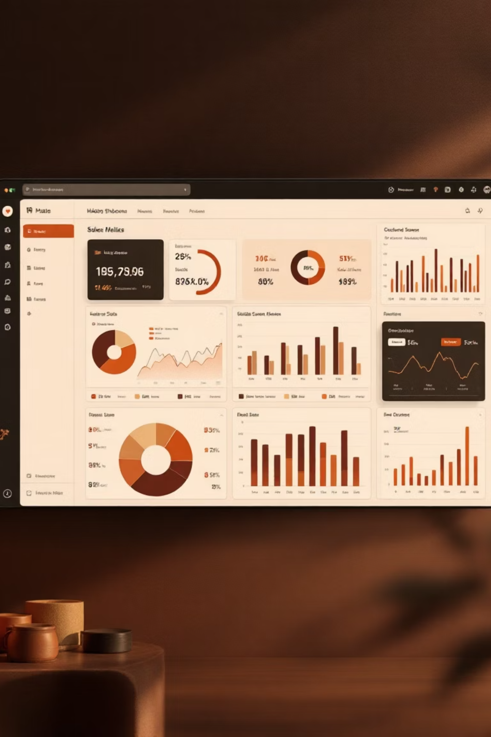
Dashboard Components
KPI Cards
Interactive Filters
Total Sales: $2.3M
Region & State selectors
Total Profit: $286.4K
Category & Sub-category
Order Count: 5,009
Date range slider
Average Discount: 15.6%
Customer segment filter
Visualization Types
Time-series charts
Geographic maps
Bar & column charts
Treemaps & pie charts

Slide 5
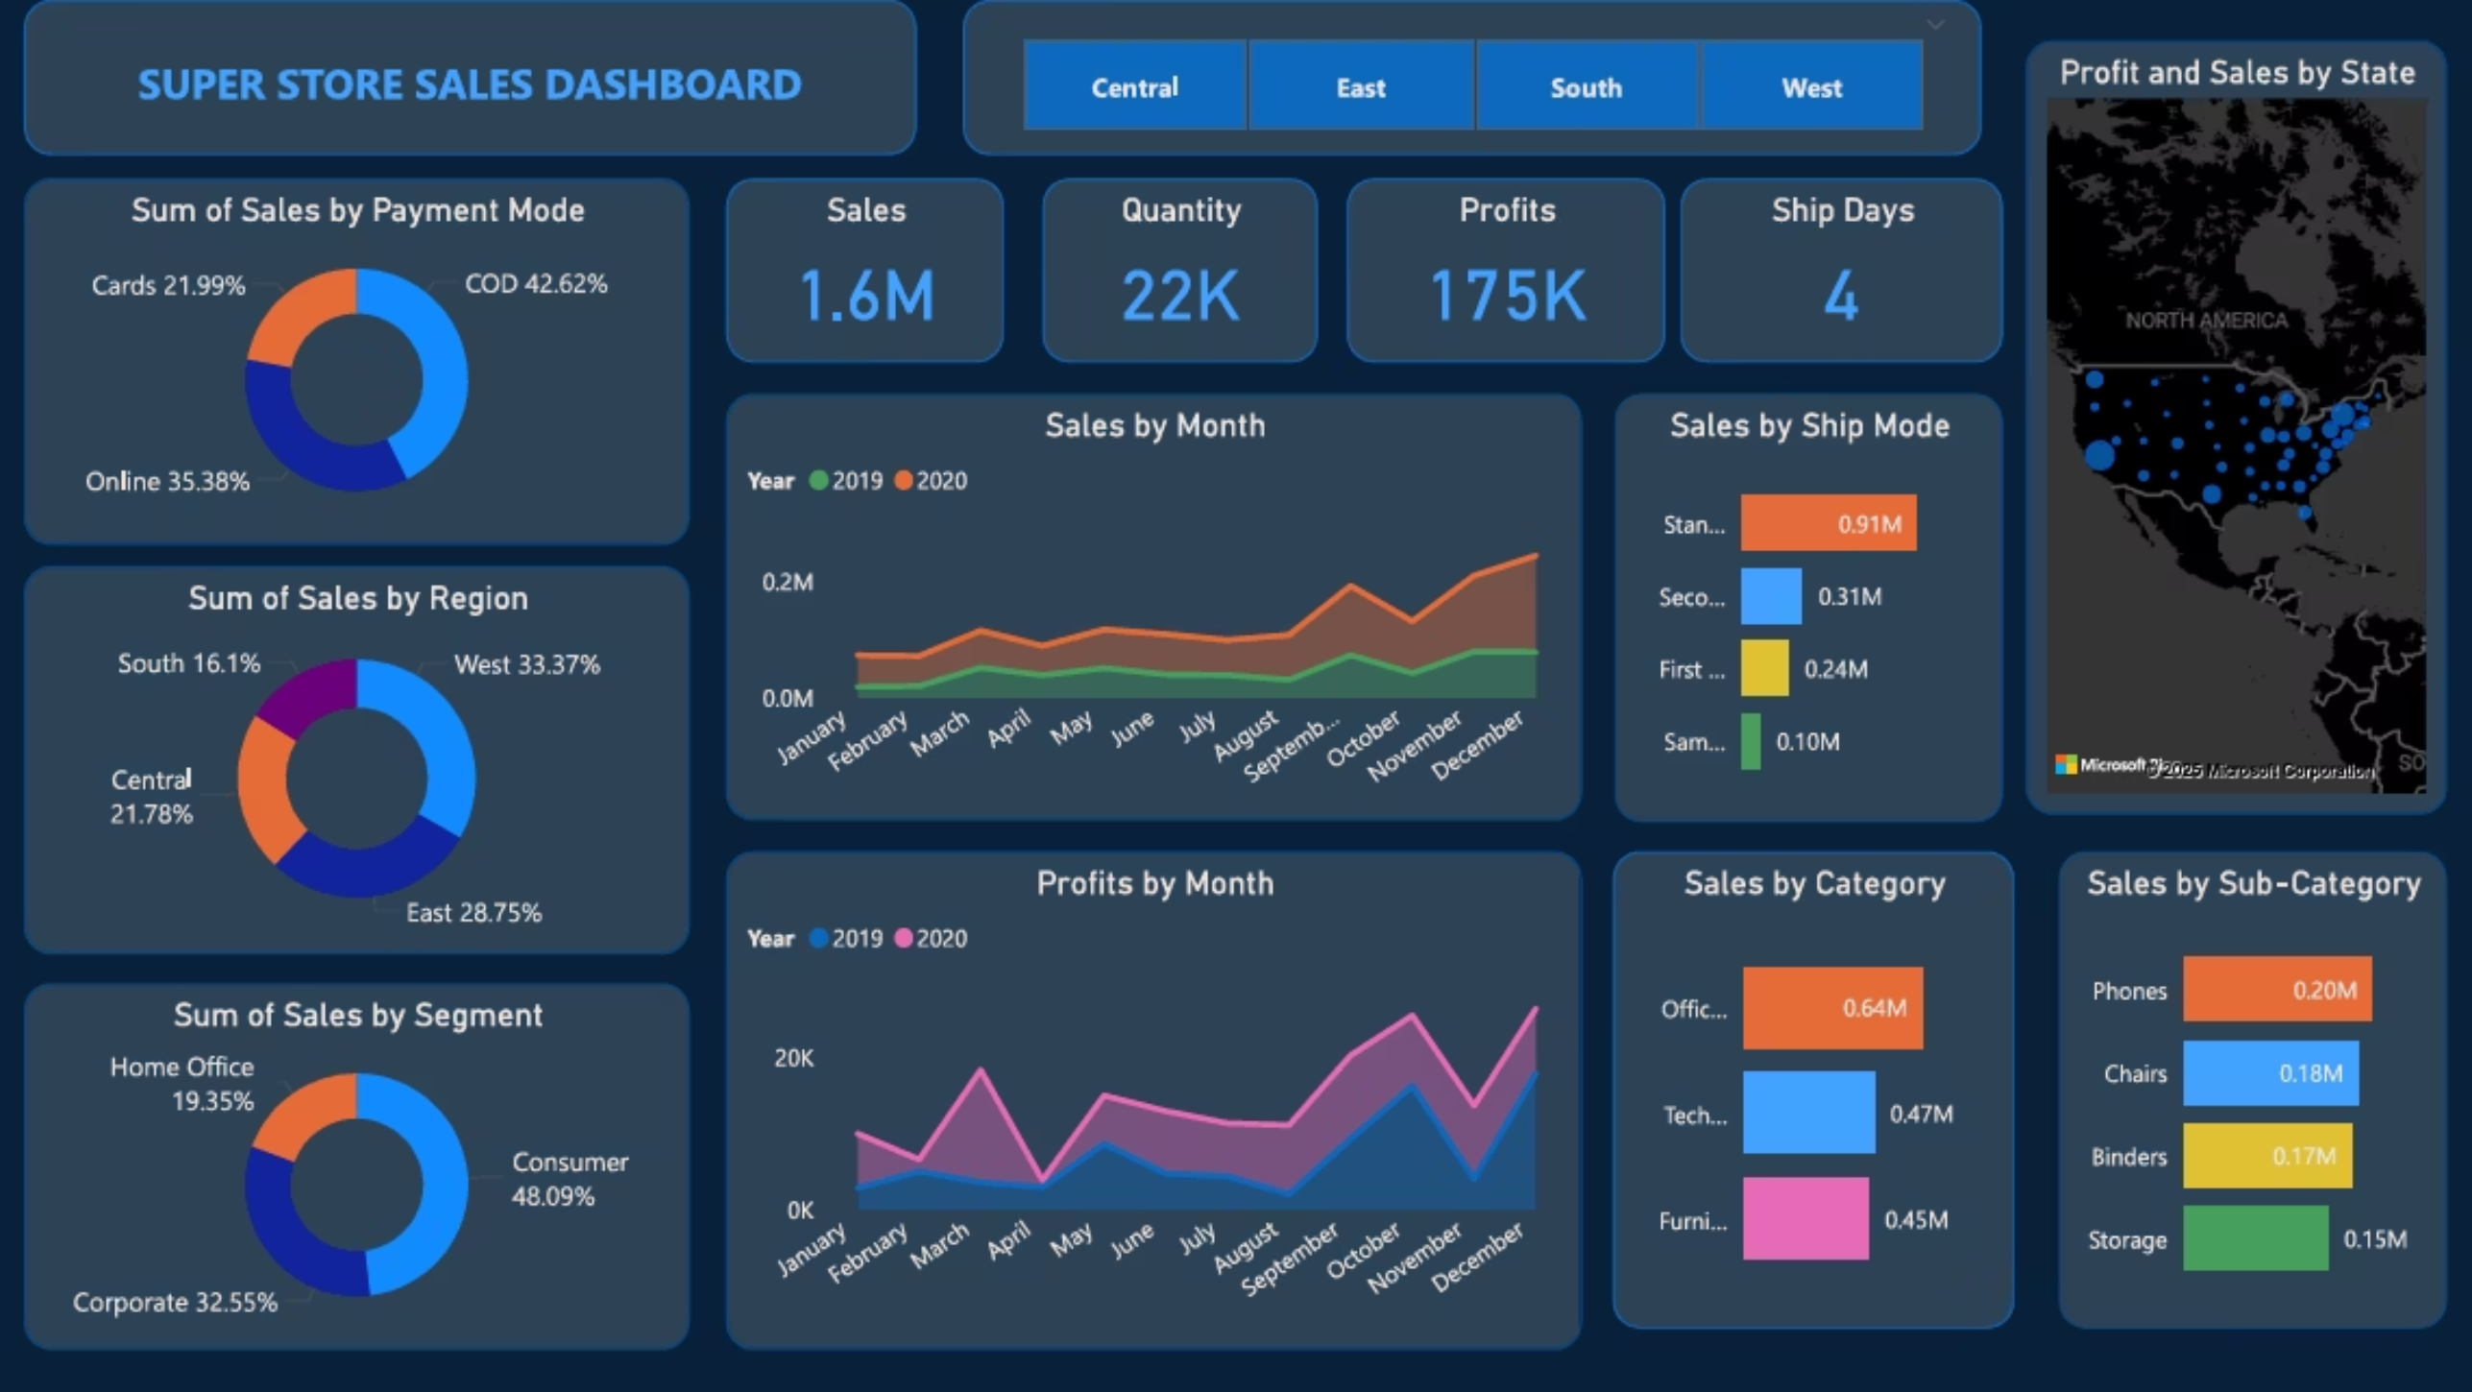
SuperStore Sales Dashboard
An interactive Power BI dashboard showing Sales, Profit, Orders, and Discount with regional, category, and time-based performance views.

Slide 6
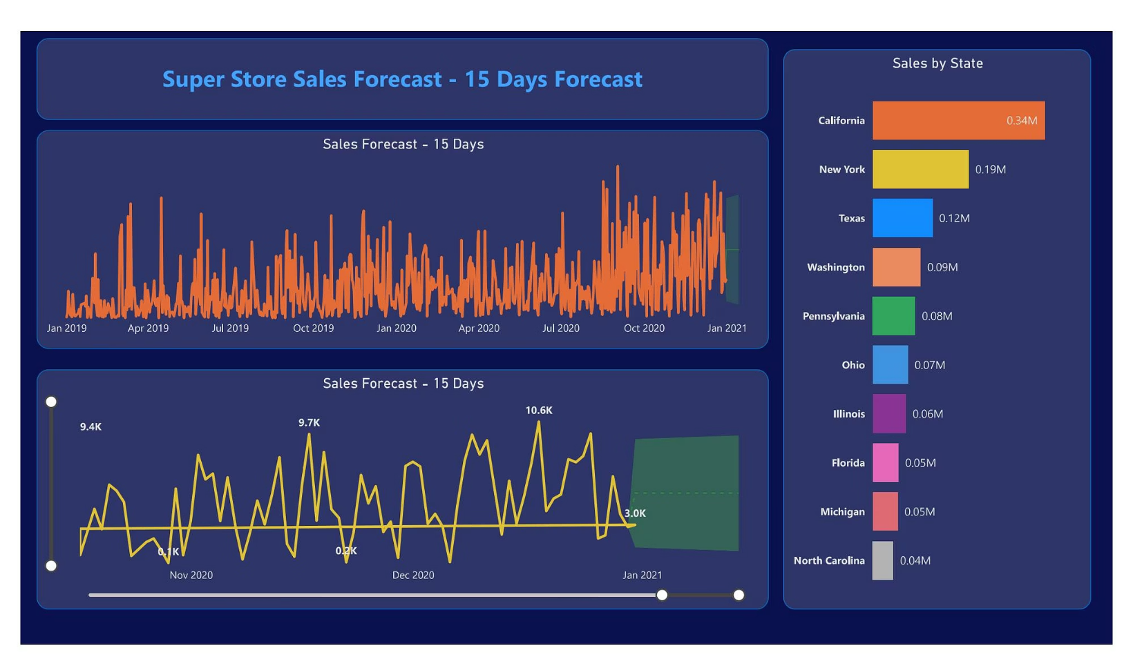
Sales Performance Analysis
Sales Distribution
The West region consistently leads in sales performance, generating 32.6% of total revenue, followed by East (29.1%), Central (21.8%), and South (16.5%).
Technology products drive the highest sales volume at $836.2K, with Office Supplies and Furniture following at $719.0K and $741.7K respectively.
Monthly sales show clear seasonal patterns with peaks in November-December and dips in February.

Slide 7




Profit Trends & Insights
Profit Leaders
Technology category maintains the highest profit margin at 17.4%, generating $145.5K in total profit.
Underperformers
Furniture shows concerning profit issues with an 8.9% margin, well below company average of 12.5%.
Root Causes
High shipping costs and excessive discounting in the Tables sub-category contribute to margin erosion.

Slide 8
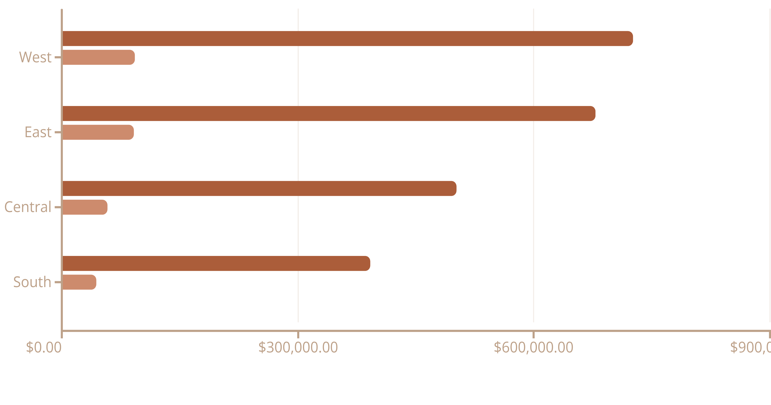
Regional Performance Breakdown
Sales ($)
Profit ($)
Profit Margin (%)
The East region shows the highest profit margin despite generating less total sales than the West, suggesting more efficient operations and potentially better customer targeting strategies.

Slide 9

Interactive Features & User Experience
Cross-Filtering
Tooltips & Drill-Through
All visualizations respond dynamically when filters are applied, allowing users to drill down into specific segments with a single click.
Enhanced tooltips provide context-sensitive details, while drill-through pages offer deeper analysis of selected products, customers, or regions.
Bookmarks & Views
Preset bookmarks enable quick access to common analysis scenarios, such as "Quarterly Performance" or "Product Category Comparison."

Slide 10
Technical Implementation
Data Preparation
Performance Optimization
Cleaned and transformed raw data using Power Query
Implemented query folding for faster data refresh
Created date hierarchy and calculated fields
Used aggregations to improve report responsiveness
Implemented star schema with dimension tables
Compressed dataset from 45MB to 28MB
DAX Measures
Accessibility Features
Developed 15+ custom DAX measures for advanced metrics:
Color schemes tested for color blindness
Year-over-Year growth: YoYGrowth = DIVIDE([Total Sales] - [PY Sales], [PY Sales])
Alt text added to all visuals
Keyboard navigation support
Rolling 3-month average

Slide 11
Conclusions & Business Recommendations
Key Findings
Recommendations
West region dominates sales but East has highest profit efficiency
Reduce discounting in Furniture category by 5%
Expand Technology offerings in Central region
Technology category drives both volume and margins
Implement targeted promotions during February sales dip
Furniture profitability needs urgent attention
Seasonal patterns offer promotional opportunities
Optimize shipping costs for Tables sub-category
This dashboard provides a foundation for data-driven decision making. Next steps include implementing scheduled refreshes, sharing with stakeholders, and developing prediction models for sales forecasting.

